Slide 1
Chapter 2: Getting Started in C++
C++ PROGRAMMING:
PRINCIPLES AND PRACTICES FOR SCIENTISTS AND ENGINEERS

Slide 2
Objectives
In this chapter, you will learn about:
Modular programs
Programming style
Data types
Arithmetic operations
Variables and declaration statements
Common programming errors

Slide 3
Introduction to C++
Modular program: A program consisting of interrelated segments (or modules) arranged in a logical and understandable form
Easy to develop, correct, and modify
Modules in C++ can be classes or functions

Slide 4
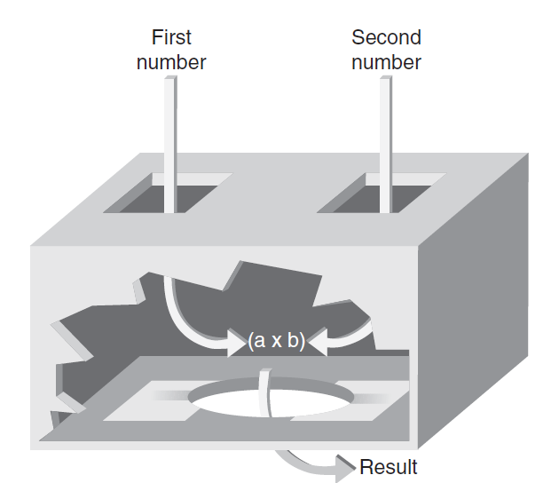

Introduction to C++ (continued)‏
Function: Accepts an input, processes the input, and produces an output
A function’s processing is encapsulated and hidden within the function

Slide 5
Introduction to C++ (continued)‏
Class: Contains both data and functions used to manipulate the data
Identifier: A name given to an element of the language, such as a class or function
Rules for forming identifier names:
First character must be a letter or underscore
Only letters, digits, or underscores may follow the initial letter (no blanks allowed)‏
Keywords cannot be used as identifiers
Maximum length of an identifier = 1024 characters

Slide 6
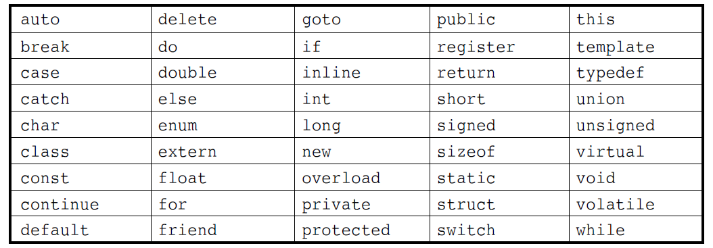
Introduction to C++ (continued)‏
Keyword: A reserved name that represents a built-in object or function of the language
Table 2.1: Keywords in C++

Slide 7
Introduction to C++ (continued)‏
Examples of valid C++ identifiers:
degToRad intersect addNums
slope bessell multTwo
findMax density
Examples of invalid C++ identifiers:
1AB3 (begins with a number)‏
E*6 (contains a special character)‏
while (this is a keyword)‏

Slide 8
Introduction to C++ (continued)‏
Function names
Require a set of parentheses at the end
Can use mixed upper and lower case
Should be meaningful, or be a mnemonic
Examples of function names:
easy() c3po() r2d2() theForce()‏
Note that C++ is a case-sensitive language!
© 2013 Cengage Learning. All Rights Reserved. This edition is intended for use outside of the U.S. only, with content that may be different from the U.S. Edition. May not be scanned, copied, duplicated, or posted to a publicly accessible website, in whole or in part.

Slide 9
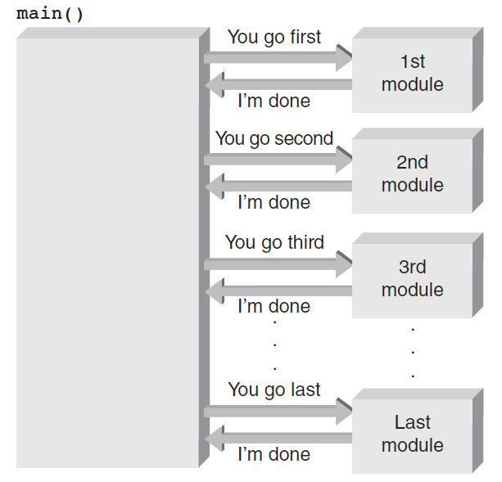
The main() Function
Overall structure of a C++ program contains one function named main(), called the driver function
All other functions are invoked from main()‏
Figure 2.3 The main() function directs all other functions.
© 2013 Cengage Learning. All Rights Reserved. This edition is intended for use outside of the U.S. only, with content that may be different from the U.S. Edition. May not be scanned, copied, duplicated, or posted to a publicly accessible website, in whole or in part.

Slide 10
The main() Function (continued)‏
Function header line: First line of a function, which contains:
The type of data returned by the function (if any)‏
The name of the function
The type of data that must be passed into the function when it is invoked (if any)‏
Arguments: The data passed into a function
Function body: The statements inside a function
enclosed in braces
© 2013 Cengage Learning. All Rights Reserved. This edition is intended for use outside of the U.S. only, with content that may be different from the U.S. Edition. May not be scanned, copied, duplicated, or posted to a publicly accessible website, in whole or in part.

Slide 11
The main() Function (continued)‏
Each statement inside the function must be terminated with a semicolon
return: A keyword causing the appropriate value to be returned from the function
The statement return 0 in the main() function causes the program to end
© 2013 Cengage Learning. All Rights Reserved. This edition is intended for use outside of the U.S. only, with content that may be different from the U.S. Edition. May not be scanned, copied, duplicated, or posted to a publicly accessible website, in whole or in part.

Slide 12
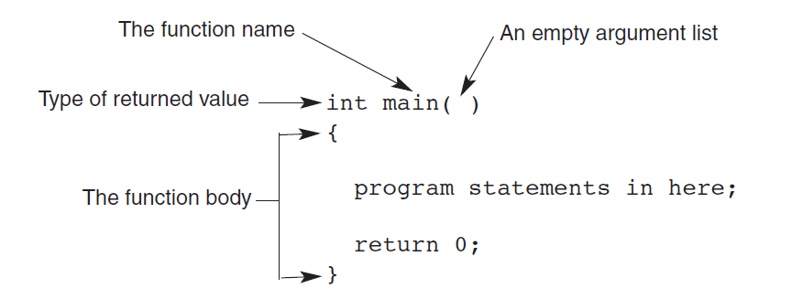
The main() Function (continued)‏
Figure 2.4 The structure of a main() function
© 2013 Cengage Learning. All Rights Reserved. This edition is intended for use outside of the U.S. only, with content that may be different from the U.S. Edition. May not be scanned, copied, duplicated, or posted to a publicly accessible website, in whole or in part.

Slide 13
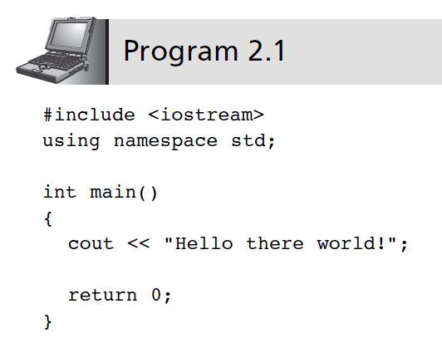
The cout Object
cout object: An output object that sends data to a standard output display device
© 2013 Cengage Learning. All Rights Reserved. This edition is intended for use outside of the U.S. only, with content that may be different from the U.S. Edition. May not be scanned, copied, duplicated, or posted to a publicly accessible website, in whole or in part.

Slide 14
The cout Object (continued)‏
Preprocessor command: Starts with a #
Causes an action before the source code is compiled into machine code
#include <file name>: Causes the named file to be inserted into the source code
C++ provides a standard library with many pre-written classes that can be included
Header files: Files included at the head (top) of a C++ program
© 2013 Cengage Learning. All Rights Reserved. This edition is intended for use outside of the U.S. only, with content that may be different from the U.S. Edition. May not be scanned, copied, duplicated, or posted to a publicly accessible website, in whole or in part.

Slide 15
The cout Object (continued)‏
using namespace <namespace name> : Indicates where header file is located
Namespaces qualify a name
A function name in your class can be the same as one used in a standard library class
String: Any combination of letters, numbers, and special characters enclosed in double quotes
Delimiter: A symbol that marks the beginning and ending of a string; not part of the string
© 2013 Cengage Learning. All Rights Reserved. This edition is intended for use outside of the U.S. only, with content that may be different from the U.S. Edition. May not be scanned, copied, duplicated, or posted to a publicly accessible website, in whole or in part.

Slide 16
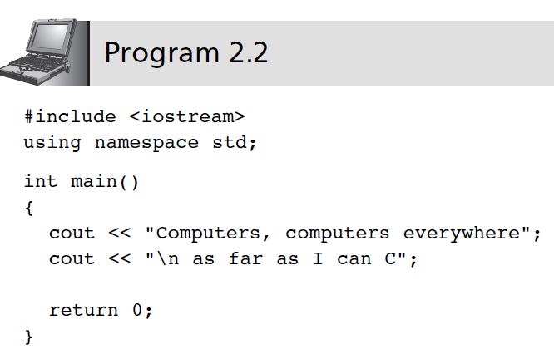
The cout Object (continued)‏
© 2013 Cengage Learning. All Rights Reserved. This edition is intended for use outside of the U.S. only, with content that may be different from the U.S. Edition. May not be scanned, copied, duplicated, or posted to a publicly accessible website, in whole or in part.

Slide 17
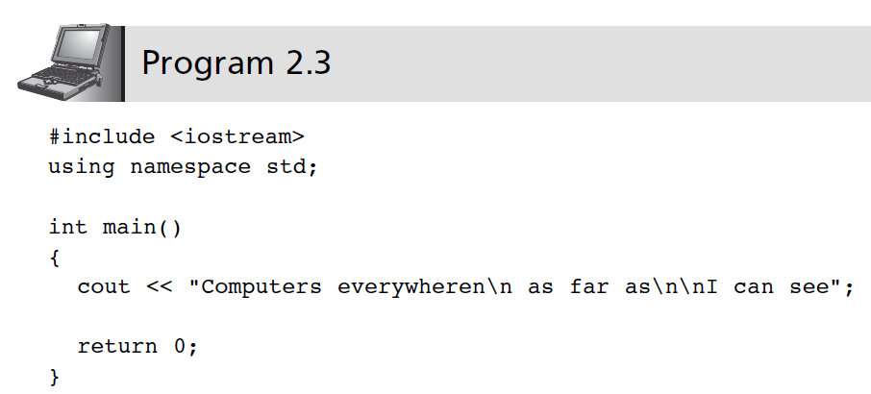
The cout Object (continued)‏
Escape sequence: One or more characters preceded by a backslash, \
© 2013 Cengage Learning. All Rights Reserved. This edition is intended for use outside of the U.S. only, with content that may be different from the U.S. Edition. May not be scanned, copied, duplicated, or posted to a publicly accessible website, in whole or in part.

Slide 18
Programming Style
Good style calls for one C++ statement per line
Opening and closing braces {} for the function body should each be on separate lines
Statements in the function body should be indented
© 2013 Cengage Learning. All Rights Reserved. This edition is intended for use outside of the U.S. only, with content that may be different from the U.S. Edition. May not be scanned, copied, duplicated, or posted to a publicly accessible website, in whole or in part.

Slide 19
Comments
Comments: Explanatory remarks in the source code added by the programmer
Line comment: Begins with // and continues to the end of the line
Example: // this program displays a message
#include <iostream>
using namespace std;
int main ()
{
cout << “Hello there world!”; //displays text
return 0;
}
© 2013 Cengage Learning. All Rights Reserved. This edition is intended for use outside of the U.S. only, with content that may be different from the U.S. Edition. May not be scanned, copied, duplicated, or posted to a publicly accessible website, in whole or in part.

Slide 20
Comments (continued)‏
Block comments: comments that span across two or more lines
Begin with /* and end with */
Example:
/* This is a block comment that
spans
across three lines */
© 2013 Cengage Learning. All Rights Reserved. This edition is intended for use outside of the U.S. only, with content that may be different from the U.S. Edition. May not be scanned, copied, duplicated, or posted to a publicly accessible website, in whole or in part.

Slide 21
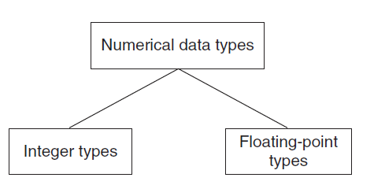
Data Types
Data type: A set of values and the operations that can be applied to these values
Two fundamental C++ data groupings:
Class data type (a class): Created by the programmer
Built-in data type (primitive type): Part of the C++ compiler
Figure 2.5 Built-in data types
© 2013 Cengage Learning. All Rights Reserved. This edition is intended for use outside of the U.S. only, with content that may be different from the U.S. Edition. May not be scanned, copied, duplicated, or posted to a publicly accessible website, in whole or in part.

Slide 22
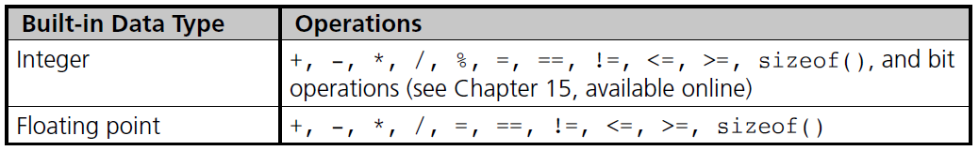
Data Types (continued)
© 2013 Cengage Learning. All Rights Reserved. This edition is intended for use outside of the U.S. only, with content that may be different from the U.S. Edition. May not be scanned, copied, duplicated, or posted to a publicly accessible website, in whole or in part.

Slide 23
Data Types (continued)‏
Literal (constant): An actual value
Examples:
3.6 //numeric literal
“Hello” //string literal
Integer: A whole number
C++ has nine built-in integer data types
Each provides different amounts of storage (compiler dependent)
© 2013 Cengage Learning. All Rights Reserved. This edition is intended for use outside of the U.S. only, with content that may be different from the U.S. Edition. May not be scanned, copied, duplicated, or posted to a publicly accessible website, in whole or in part.

Slide 24
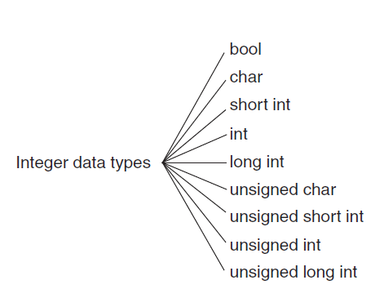
Integer Data Types
Figure 2.6 C++ integer data types
© 2013 Cengage Learning. All Rights Reserved. This edition is intended for use outside of the U.S. only, with content that may be different from the U.S. Edition. May not be scanned, copied, duplicated, or posted to a publicly accessible website, in whole or in part.

Slide 25
Integer Data Types (continued)‏
int data type: Whole numbers (integers), optionally with plus (+) or minus (–) sign
Example: 2, -5
char data type: Individual character; any letter, digit, or special character enclosed in single quotes
Example: ‘A’
Character values are usually stored in ASCII code
© 2013 Cengage Learning. All Rights Reserved. This edition is intended for use outside of the U.S. only, with content that may be different from the U.S. Edition. May not be scanned, copied, duplicated, or posted to a publicly accessible website, in whole or in part.

Slide 26
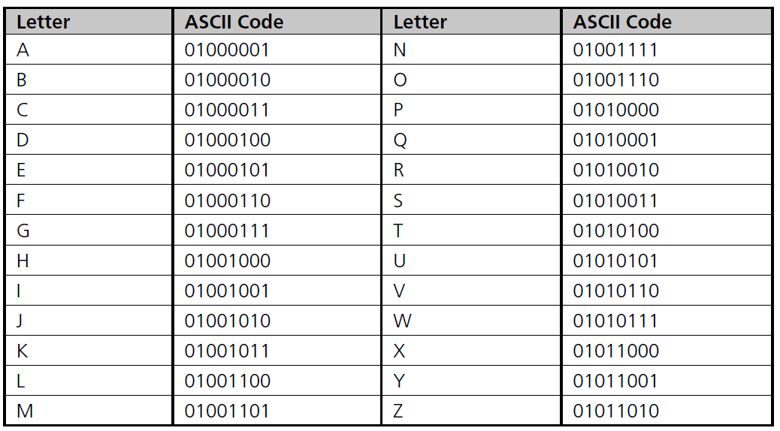
Integer Data Types (continued)‏
Table 2.3 The ASCII Uppercase Letter Codes
© 2013 Cengage Learning. All Rights Reserved. This edition is intended for use outside of the U.S. only, with content that may be different from the U.S. Edition. May not be scanned, copied, duplicated, or posted to a publicly accessible website, in whole or in part.

Slide 27
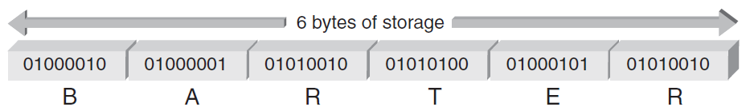
Integer Data Types (continued)‏
When storing the ASCII codes shown in Table 2.3 to represent text, each letter takes one byte of memory and is represented by the associated number from the chart
Figure 2.7 The letters BARTER stored inside a computer
© 2013 Cengage Learning. All Rights Reserved. This edition is intended for use outside of the U.S. only, with content that may be different from the U.S. Edition. May not be scanned, copied, duplicated, or posted to a publicly accessible website, in whole or in part.

Slide 28
Integer Data Types (continued)‏
Escape character: The backslash, \
Indicates an escape sequence
Escape sequence: Tells compiler to treat the following characters as special instruction codes
© 2013 Cengage Learning. All Rights Reserved. This edition is intended for use outside of the U.S. only, with content that may be different from the U.S. Edition. May not be scanned, copied, duplicated, or posted to a publicly accessible website, in whole or in part.

Slide 29
Integer Data Types (continued)‏
bool data type: Represents Boolean (logical) data
Restricted to two values: true or false
Useful when a program must examine a condition and take a prescribed course of action, based on whether the condition is true or false
© 2013 Cengage Learning. All Rights Reserved. This edition is intended for use outside of the U.S. only, with content that may be different from the U.S. Edition. May not be scanned, copied, duplicated, or posted to a publicly accessible website, in whole or in part.

Slide 30
Determining Storage Size
A unique feature of C++ is that you can see where and how values are stored
sizeof() operator provides the number of bytes used to store values of the data type named in the parenthesis
Values returned by sizeof() are compiler dependent
© 2013 Cengage Learning. All Rights Reserved. This edition is intended for use outside of the U.S. only, with content that may be different from the U.S. Edition. May not be scanned, copied, duplicated, or posted to a publicly accessible website, in whole or in part.

Slide 31
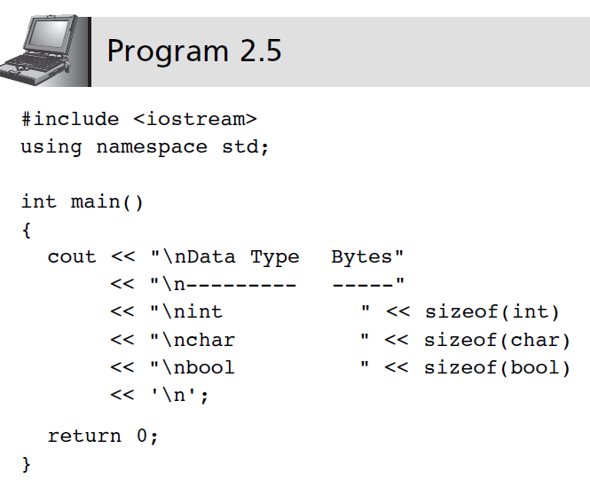
Determining Storage Size (continued)‏
© 2013 Cengage Learning. All Rights Reserved. This edition is intended for use outside of the U.S. only, with content that may be different from the U.S. Edition. May not be scanned, copied, duplicated, or posted to a publicly accessible website, in whole or in part.

Slide 32
Signed and Unsigned Data Types
Signed data type: One that permits negative, positive, and zero values
Unsigned data type: Permits only positive and zero values
An unsigned data type provides essentially double the range of its signed counterpart
© 2013 Cengage Learning. All Rights Reserved. This edition is intended for use outside of the U.S. only, with content that may be different from the U.S. Edition. May not be scanned, copied, duplicated, or posted to a publicly accessible website, in whole or in part.

Slide 33
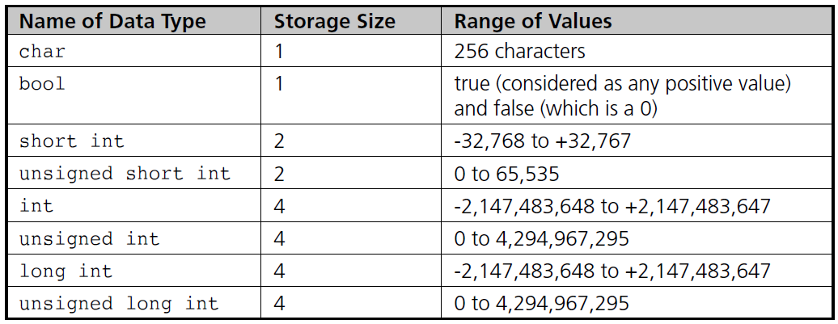
Signed and Unsigned Data Types (continued)‏
Table 2.5 Integer Data Type Storage
© 2013 Cengage Learning. All Rights Reserved. This edition is intended for use outside of the U.S. only, with content that may be different from the U.S. Edition. May not be scanned, copied, duplicated, or posted to a publicly accessible website, in whole or in part.

Slide 34
Floating-Point Types
Floating-point number (real number): Zero or any positive or negative number containing a decimal point
Examples: +10.625 5. -6.2
No special characters are allowed
Three floating-point data types in C++:
float (single precision)‏
double (double precision)‏
long double
© 2013 Cengage Learning. All Rights Reserved. This edition is intended for use outside of the U.S. only, with content that may be different from the U.S. Edition. May not be scanned, copied, duplicated, or posted to a publicly accessible website, in whole or in part.

Slide 35
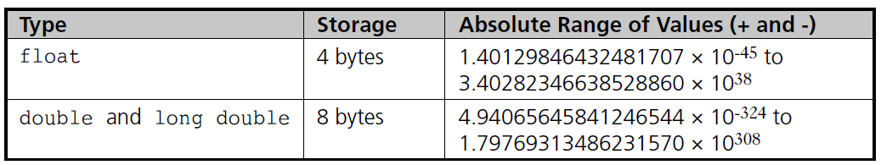
Floating-Point Types (continued)‏
Table 2.6 Floating-Point Data Types
© 2013 Cengage Learning. All Rights Reserved. This edition is intended for use outside of the U.S. only, with content that may be different from the U.S. Edition. May not be scanned, copied, duplicated, or posted to a publicly accessible website, in whole or in part.

Slide 36
Floating-Point Types (continued)‏
float literal: Append an f or F to the number
long double literal: Append an l or L to the number
Examples:
9.234 // a double literal
9.234F // a float literal
9.234L // a long double literal
© 2013 Cengage Learning. All Rights Reserved. This edition is intended for use outside of the U.S. only, with content that may be different from the U.S. Edition. May not be scanned, copied, duplicated, or posted to a publicly accessible website, in whole or in part.

Slide 37
Arithmetic Operations
C++ supports addition, subtraction, multiplication, division, and modulus division
Different data types can be used in the same arithmetic expression
Arithmetic operators are binary operators
Binary operators: Require two operands
Unary operator: Requires only one operand
Negation operator (-): Reverses the sign of the number
© 2013 Cengage Learning. All Rights Reserved. This edition is intended for use outside of the U.S. only, with content that may be different from the U.S. Edition. May not be scanned, copied, duplicated, or posted to a publicly accessible website, in whole or in part.

Slide 38
Arithmetic Operations (continued)‏
Operation
Operator
Addition
+
Subtraction
-
Multiplication
*
Division
/
Modulus division
%
© 2013 Cengage Learning. All Rights Reserved. This edition is intended for use outside of the U.S. only, with content that may be different from the U.S. Edition. May not be scanned, copied, duplicated, or posted to a publicly accessible website, in whole or in part.

Slide 39
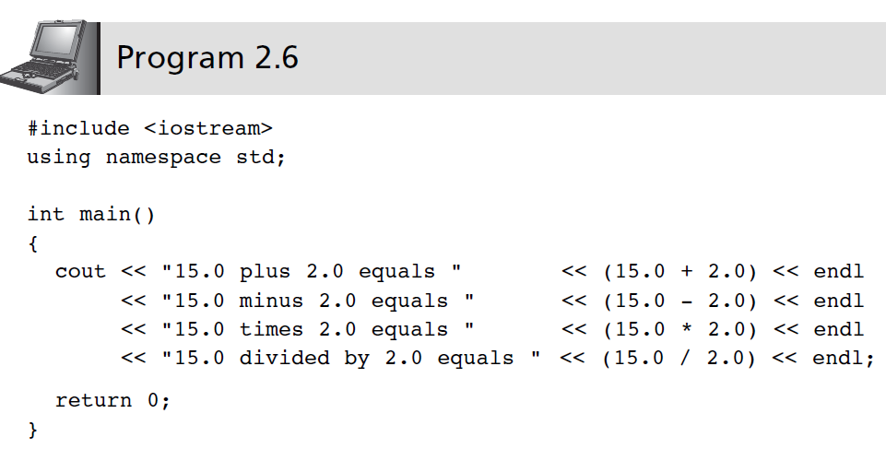
Arithmetic Operations (continued)‏
© 2013 Cengage Learning. All Rights Reserved. This edition is intended for use outside of the U.S. only, with content that may be different from the U.S. Edition. May not be scanned, copied, duplicated, or posted to a publicly accessible website, in whole or in part.

Slide 40
Expression Types
Expression: Any combination of operators and operands that can be evaluated to yield a value
If all operands are the same data type, the expression is named by the data type used (integer expression, floating-point expression, etc.)‏
Mixed-mode expression: Contains integer and floating-point operands
Yields a double-precision value
© 2013 Cengage Learning. All Rights Reserved. This edition is intended for use outside of the U.S. only, with content that may be different from the U.S. Edition. May not be scanned, copied, duplicated, or posted to a publicly accessible website, in whole or in part.

Slide 41
Integer Division
Integer division: Yields an integer result
Any fractional remainders are dropped (truncated)‏
Example: 15/2 yields 7
Modulus (remainder) operator: Returns only the remainder
Example: 9 % 4 yields 1
© 2013 Cengage Learning. All Rights Reserved. This edition is intended for use outside of the U.S. only, with content that may be different from the U.S. Edition. May not be scanned, copied, duplicated, or posted to a publicly accessible website, in whole or in part.

Slide 42
Operator Precedence and Associativity
Rules for writing arithmetic expressions:
Never place two consecutive binary arithmetic operators side by side
Use parentheses to form groupings
Contents within parentheses are evaluated first
May nest parentheses within other parentheses
Evaluated from innermost to outermost
Use the * operator for multiplication, not parentheses
© 2013 Cengage Learning. All Rights Reserved. This edition is intended for use outside of the U.S. only, with content that may be different from the U.S. Edition. May not be scanned, copied, duplicated, or posted to a publicly accessible website, in whole or in part.

Slide 43
Operator Precedence and Associativity (continued)‏
Expressions with multiple operators are evaluated by precedence of operators:
All negations occur first
Multiplication, division, and modulus are next, from left to right
Addition and subtraction are last, from left to right
© 2013 Cengage Learning. All Rights Reserved. This edition is intended for use outside of the U.S. only, with content that may be different from the U.S. Edition. May not be scanned, copied, duplicated, or posted to a publicly accessible website, in whole or in part.

Slide 44
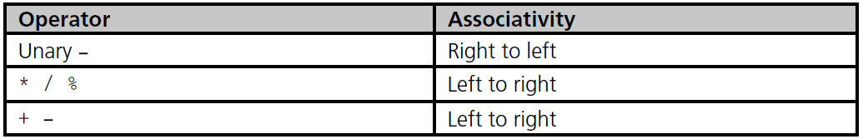
Operator Precedence and Associativity (continued)‏
Associativity: the order in which operators of the same precedence are evaluated
Table 2.8 Operator Precedence and Associativity
© 2013 Cengage Learning. All Rights Reserved. This edition is intended for use outside of the U.S. only, with content that may be different from the U.S. Edition. May not be scanned, copied, duplicated, or posted to a publicly accessible website, in whole or in part.

Slide 45
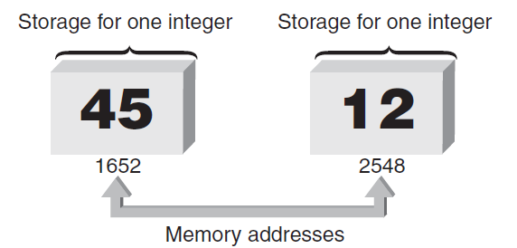
Variables and Declaration Statements
Variable: All integer, float-point, and other values used in a program are stored and retrieved from the computer's memory
Each memory location has a unique address
Figure 2.8 Enough storage for two integers
© 2013 Cengage Learning. All Rights Reserved. This edition is intended for use outside of the U.S. only, with content that may be different from the U.S. Edition. May not be scanned, copied, duplicated, or posted to a publicly accessible website, in whole or in part.

Slide 46
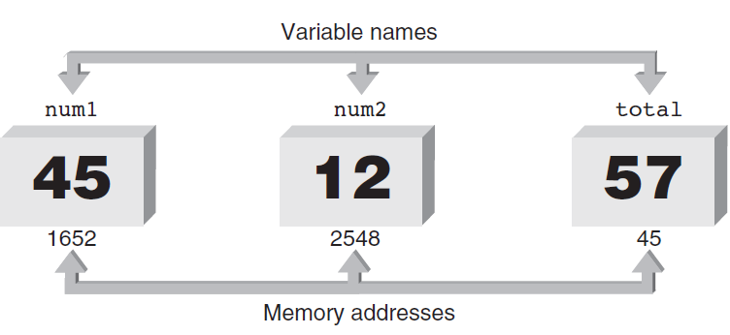
Variables and Declaration Statements (continued)‏
Variable: Symbolic identifier for a memory address where data can be held
Use identifier naming rules for variable names
Figure 2.9 Naming storage locations
© 2013 Cengage Learning. All Rights Reserved. This edition is intended for use outside of the U.S. only, with content that may be different from the U.S. Edition. May not be scanned, copied, duplicated, or posted to a publicly accessible website, in whole or in part.

Slide 47
Variables and Declaration Statements (continued)‏
Assignment statement: Used to store a value into a variable
Value of the expression on the right is assigned to the memory location of the variable on the left side
Examples:
num1 = 45;
num2 = 12;
total = num1 + num2;
© 2013 Cengage Learning. All Rights Reserved. This edition is intended for use outside of the U.S. only, with content that may be different from the U.S. Edition. May not be scanned, copied, duplicated, or posted to a publicly accessible website, in whole or in part.

Slide 48
Variables and Declaration Statements (continued)‏
Declaration statement: Specifies the data type and identifier of a variable; sets up the memory location
Syntax: dataType variableName;
Data type is any valid C++ data type
Example: int sum;
Declarations may be used anywhere in a function
Usually grouped at the opening brace
© 2013 Cengage Learning. All Rights Reserved. This edition is intended for use outside of the U.S. only, with content that may be different from the U.S. Edition. May not be scanned, copied, duplicated, or posted to a publicly accessible website, in whole or in part.

Slide 49
Variables and Declaration Statements (continued)‏
Character variables: Declared using the char keyword
Multiple variables of the same data type can be declared in a single declaration statement
Example:
double grade1, grade2, total, average;
Variables can be initialized in a declaration
Example:
double grade1 = 87.0
A variable must be declared before it is used
© 2013 Cengage Learning. All Rights Reserved. This edition is intended for use outside of the U.S. only, with content that may be different from the U.S. Edition. May not be scanned, copied, duplicated, or posted to a publicly accessible website, in whole or in part.

Slide 50
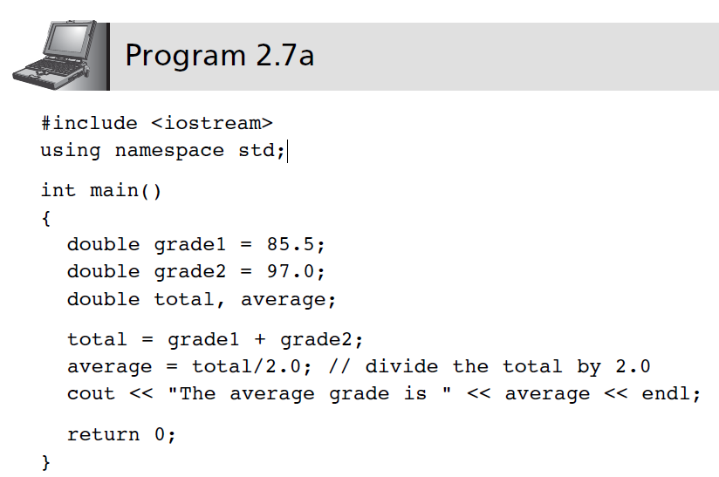
Variables and Declaration Statements (continued)‏
© 2013 Cengage Learning. All Rights Reserved. This edition is intended for use outside of the U.S. only, with content that may be different from the U.S. Edition. May not be scanned, copied, duplicated, or posted to a publicly accessible website, in whole or in part.

Slide 51
Memory Allocation
Definition statement: A declaration that defines how much memory is needed for data storage
Three items associated with each variable:
Data type
Actual value stored in the variable (its contents)‏
Memory address of the variable
Address operator (&) provides the variable’s address
© 2013 Cengage Learning. All Rights Reserved. This edition is intended for use outside of the U.S. only, with content that may be different from the U.S. Edition. May not be scanned, copied, duplicated, or posted to a publicly accessible website, in whole or in part.

Slide 52
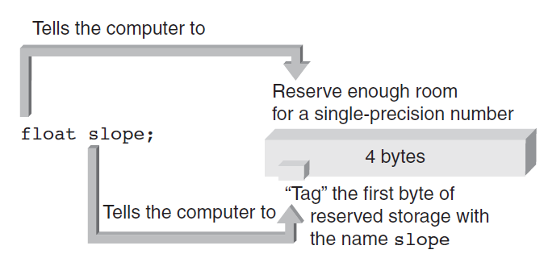
Memory Allocation (continued)‏
Declaring a variable causes memory to be allocated based on the data type
Figure 2.10b Defining the floating-point variable named slope
© 2013 Cengage Learning. All Rights Reserved. This edition is intended for use outside of the U.S. only, with content that may be different from the U.S. Edition. May not be scanned, copied, duplicated, or posted to a publicly accessible website, in whole or in part.

Slide 53
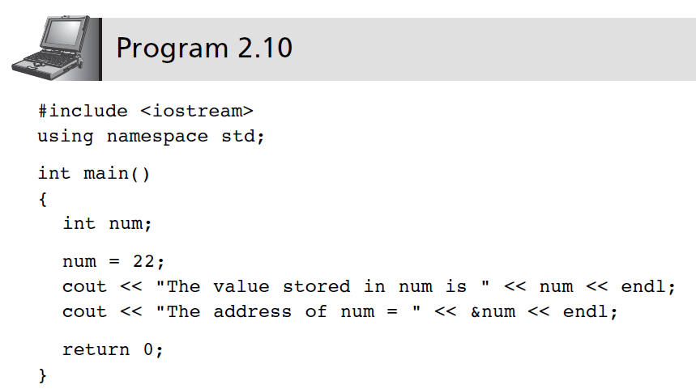
Memory Allocation (continued)‏
© 2013 Cengage Learning. All Rights Reserved. This edition is intended for use outside of the U.S. only, with content that may be different from the U.S. Edition. May not be scanned, copied, duplicated, or posted to a publicly accessible website, in whole or in part.

Slide 54
A Case Study: Radar Speed Trap
Step 1: Analyze the Problem
Understand the desired outputs
Determine the required inputs
Step 2: Develop a Solution
Determine the algorithms to be used
Use top-down approach to design
Step 3: Code the Solution
Step 4: Test and Correct the Program
© 2013 Cengage Learning. All Rights Reserved. This edition is intended for use outside of the U.S. only, with content that may be different from the U.S. Edition. May not be scanned, copied, duplicated, or posted to a publicly accessible website, in whole or in part.

Slide 55
A Case Study: Radar Speed Trap (continued)‏
Analyze the Problem
Output: Speed of the car
Inputs: Emitted frequency and received frequency
Develop a Solution
Algorithm:
Assign values to f0 and f1
Calculate and display speed
© 2013 Cengage Learning. All Rights Reserved. This edition is intended for use outside of the U.S. only, with content that may be different from the U.S. Edition. May not be scanned, copied, duplicated, or posted to a publicly accessible website, in whole or in part.

Slide 56
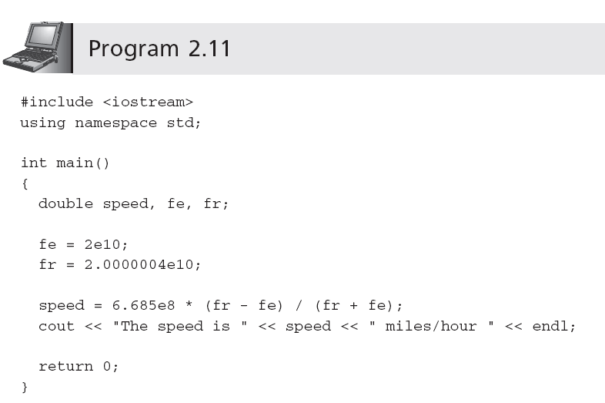
A Case Study: Radar Speed Trap (continued)‏
Code the Solution
© 2013 Cengage Learning. All Rights Reserved. This edition is intended for use outside of the U.S. only, with content that may be different from the U.S. Edition. May not be scanned, copied, duplicated, or posted to a publicly accessible website, in whole or in part.

Slide 57
A Case Study: Radar Speed Trap (continued)‏
Test and Correct the Program
Verify that the calculation and displayed value agree with the previous hand calculation
Use the program with different values of received frequencies
© 2013 Cengage Learning. All Rights Reserved. This edition is intended for use outside of the U.S. only, with content that may be different from the U.S. Edition. May not be scanned, copied, duplicated, or posted to a publicly accessible website, in whole or in part.

Slide 58
Common Programming Errors
Omitting the parentheses after main()‏
Omitting or incorrectly typing the opening brace, {, or the closing brace, }, that signifies the start and end of a function body
Misspelling the name of an object or function
Forgetting to enclose a string sent to cout with quotation marks
Omitting a semicolon at end of statement
© 2013 Cengage Learning. All Rights Reserved. This edition is intended for use outside of the U.S. only, with content that may be different from the U.S. Edition. May not be scanned, copied, duplicated, or posted to a publicly accessible website, in whole or in part.

Slide 59
Common Programming Errors (continued)‏
Adding a semicolon at end of #include statement
Missing \n to indicate new line
Substituting letter O for zero and vice versa
Failing to declare all variables
© 2013 Cengage Learning. All Rights Reserved. This edition is intended for use outside of the U.S. only, with content that may be different from the U.S. Edition. May not be scanned, copied, duplicated, or posted to a publicly accessible website, in whole or in part.

Slide 60
Common Programming Errors (continued)‏
Storing an incorrect data type into a variable
Attempting to use a variable with no value
Dividing integer values incorrectly
Mixing data types in the same expression
© 2013 Cengage Learning. All Rights Reserved. This edition is intended for use outside of the U.S. only, with content that may be different from the U.S. Edition. May not be scanned, copied, duplicated, or posted to a publicly accessible website, in whole or in part.

Slide 61
Summary
A C++ program consists of one or more modules, called functions, one of which must be called main()‏
All C++ statements must be terminated by a semicolon
Data types include int, float, bool, char
cout object can be used to display data
cout object requires the preprocessor command #include <iostream>
© 2013 Cengage Learning. All Rights Reserved. This edition is intended for use outside of the U.S. only, with content that may be different from the U.S. Edition. May not be scanned, copied, duplicated, or posted to a publicly accessible website, in whole or in part.

Slide 62
Summary (continued)‏
Variables must be declared with their data type
A variable can be used only after it has been declared
Variables may be initialized when declared
Definition statement causes computer to allocate memory for a variable
sizeof() operator yields the amount of storage reserved for a variable
© 2013 Cengage Learning. All Rights Reserved. This edition is intended for use outside of the U.S. only, with content that may be different from the U.S. Edition. May not be scanned, copied, duplicated, or posted to a publicly accessible website, in whole or in part.

Slide 63
EX 1.
C=32.0
F=9/5*C+32
Print out C, F

Slide 64
Ex2.
A ball with radius, r=2.0
Print out volume of the ball

